Slide 1
Read It! Station Instructions
Each member of the group will read the passage and answer the questions from the task cards on the lab sheet in the Read It! section.
It is important to remember that the answers will come directly from the reading passage.
INPUT STATION

Slide 2
Natural Selection and Artificial Selection
Both natural selection and artificial selection causes changes in plants and animals. Natural selection is the process where the traits that make an organism better adapted to the environment so that they survive and reproduce are passed on to the next generation. The phrase “survival of the fittest” refers to natural selection. If the organism is not well adapted to its environment, it might die. Artificial selection (selective breeding) is the process that occurs when humans breed plants or animals for specific traits – for example, a dog with brown fur. There must be diversity for natural selection to occur. Diversity means there are differences in traits of organisms within a population. The differences in traits must impact the individuals' ability to survive – being well camouflaged is one example. These traits must be inherited or passed down to their offspring. Offspring are the young born from a living organism. In natural selection, for an organism to be successful because of a particular trait, this success is driven by natural processes like predators, weather conditions, and environmental pressures. Natural selection is "cause and effect" in action. Adaptations occur through natural selection. An adaptation is a trait or behavior that happens over time that helps an organism survive and function better in their environment. Artificial selection requires human involvement. People choose to modify particular traits to achieve a specific purpose. | An example would be selective breeding for a specific trait in a pet or increased yield (more crops grown) and nutritional value in plant foods. Traits that are the result of artificial selection typically just benefit the people selecting them. Some scientists are going farther than artificial selection with the introduction of genetic modification. Genetic modification is very similar to selective breeding. In a genetic modification, the genetic material, or DNA, has been changed to produce a desired trait. Herbicide-resistant crops were created through genetic modification. Natural selection relies on diversity in a population and keeps the fittest members of a population with other organisms in its ecosystem. Artificial selection removes individuals with the most desirable traits from the rest of the population. The result is very little diversity. Some undesirable traits, like narcolepsy or hip problems, are common problems in certain dog breeds. These problems exist because humans have helped purebred dogs survive and breed, so these genetic problems continue to be passed on from generation to generation. The debate over artificial selection has risen over concerns about genetically modified (GM) crops. The American Academy of Environmental Medicine has decided to stop the production of some GM crops until the safety and value has been determined.

Slide 3
Natural Selection and Artificial Selection
Natural selection and artificial selection creates change in plants and animals. Natural selection is the process where the traits that allow an organism to better survive and create more offspring are passed on to the next generation. The phrase “survival of the fittest” refers to natural selection. Artificial selection (selective breeding) is the process that occurs when humans breed plants or animals for specific traits. This happens when humans take the place of nature. There must be diversity, or differences in traits of organisms in a population, for natural selection to occur. The differences in traits must help the organism survive, an example being well camouflaged. These traits must be inherited or passed down from parent to offspring. Offspring are the young born from another living organism. In natural selection, for an organism to be successful because of the trait, the success must be caused by natural processes. These could be predators, weather, or changes in the environment. Natural selection is "cause and effect" in action. Adaptations occur because of natural selection. An adaptation is a trait or behavior that happens over time that helps an organism survive and function better in their environment. | Humans play a role in artificial selection. Humans choose to modify a certain trait to achieve a specific purpose. An example would be picking a specific trait in an animal and breeding it to get that trait. Artificially selected traits do not improve the fitness of an organism. Instead, they encourage a trait that people want. Some scientists are going farther than artificial selection with the introduction of genetic modification. Genetic modification occurs when the genetic material, the DNA, is changed to produce a desired trait, like selective breeding. This is how weed killers for tough crops were developed. Natural selection relies on diversity in a population, so the fittest members will survive. Humans developed purebred dogs to live and breed, so genetic problems continue to be passed on from parent to offspring-genetic problems like hip problems or breathing problems. The debate over artificial selection has risen to new levels with concerns over genetically modified crops. The American Academy of Environmental Medicine has decided to stop the production of some GM crops until the safety and value has been determined.

Slide 4
Input:
Read
It!
The phrase "Survival of the Fittest" would best describe...
Input:
Read
It!
What is one problem with
artificial selection?
1 of 4
2 of 4
Natural selection
Artificial selection
Selective breeding
None of the above
It takes thousands of years.
It removes diversity and bad traits can surface.
It promotes biodiversity of the species.
It can only happen once a year.
Input:
Read
It!
Which is not true about natural selection?
Input:
Read
It!
3 of 4
4 of 4
There must be diversity in the population.
It is driven by natural processes like predators or weather conditions.
Humans are involved and can select the most desirable organisms.
Predators, geological activity, and weather can all have an impact on organisms.
There are vocabulary words on your answer sheet. Use the space around them to jot down notes or drawings to help you remember their meanings from the reading.

Slide 5
Watch It! Station Instructions
Each member of the group will go to the website listed on task card #1.
Complete the task cards in order.
Every student will answer the questions from the task cards on the lab sheet in the Watch It! section of the lab sheet.
INPUT STATION

Slide 6
Input:
Watch
It!
YouTube: https://www.youtube.com/watch?v=0SCjhI86grU&list=PLfHpBjIQ933sGLwYXkR6CymO8Hxd9wyvb
Input:
Watch
It!
1 of 4
2 of 4
How can humans selectively breed a vegetable to produce a more desirable crop?
Click Play on the video.
Answer questions from cards #2-4 on
your lab sheet.
Input:
Watch
It!
Input:
Watch
It!
3 of 4
4 of 4
What is natural selection?
Explain how natural selection allows beetles that are camouflaged to flourish in their environment.

Slide 7
Explore It! Station Instructions
One member of the group will read the task cards in order. The group will be responsible for completing each of the tasks that are being read.
Each member of the group will then write their conclusions down on the lab sheet in the Explore It! section.
INPUT STATION

Slide 8
Input:
Explore
It!
Prior to the Industrial Revolution, most of the trees in-between London and Manchester England had light bark and white lichens growing on them.
Input:
Explore
It!
1 of 6
2 of 6
Prior to the Industrial Revolution, black moths were very rare in this area of England because they were easily hunted by predators.
Place all eight moths on the “Pre-Industrial Revolution” tree.
If you were a predator bird, which moth would be easier prey to hunt? Why?
Remove those moths.
Input:
Explore
It!
During the Industrial Revolution, the same trees became covered with soot from the new coal plants. The lichens also died off.
Input:
Explore
It!
After the beginning of the industrial revolution, the black moth population was nearly 98% of all moths in this region. This was a turnaround of nearly 100%.
3 of 6
4 of 6
Place all eight moths on the “Post-Industrial Revolution” tree.
If you were a predator bird, which moth would be easier prey to hunt? Why?
Remove those moths.
Did the moths change color over this time period?
Why were black moths the majority of the population during this time period?

Slide 9
Input:
Explore
It!
Input:
Explore
It!
5 of 6
6 of 6
This process is called natural selection. Natural selection is the process by which organisms are enabled to adapt to specific environmental pressures, predators, changes in climate, or competition for food. They will tend to survive and reproduce in greater numbers than others of their kind.
Think about long-neck and short-neck giraffes. What would happen over time if all the shrubs and lower leaves on the trees disappeared?
Would the short neck giraffes grow longer necks?

Slide 10
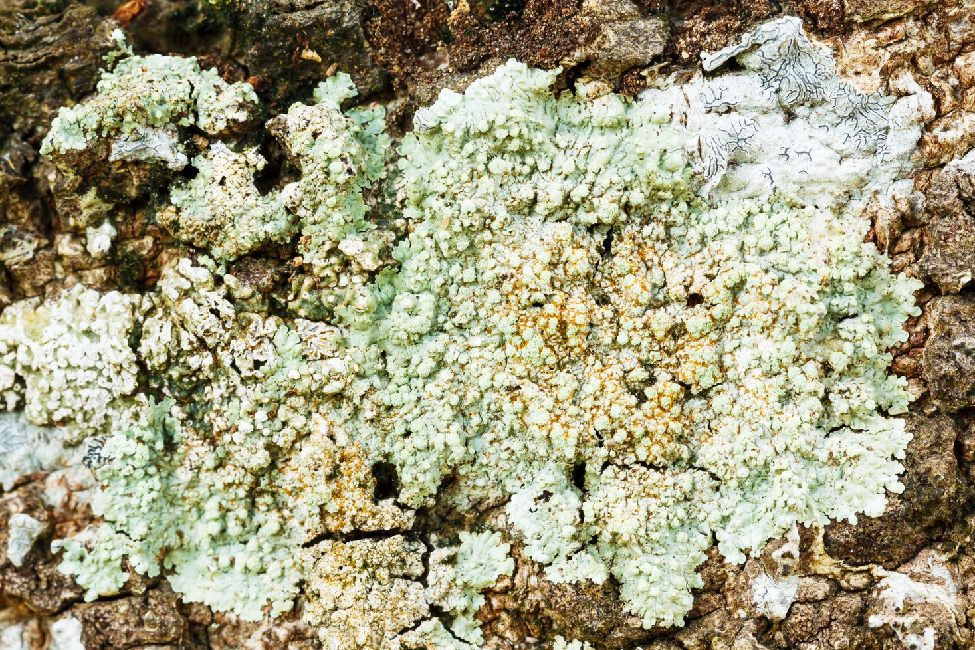
Pre-Industrial Revolution

Slide 11
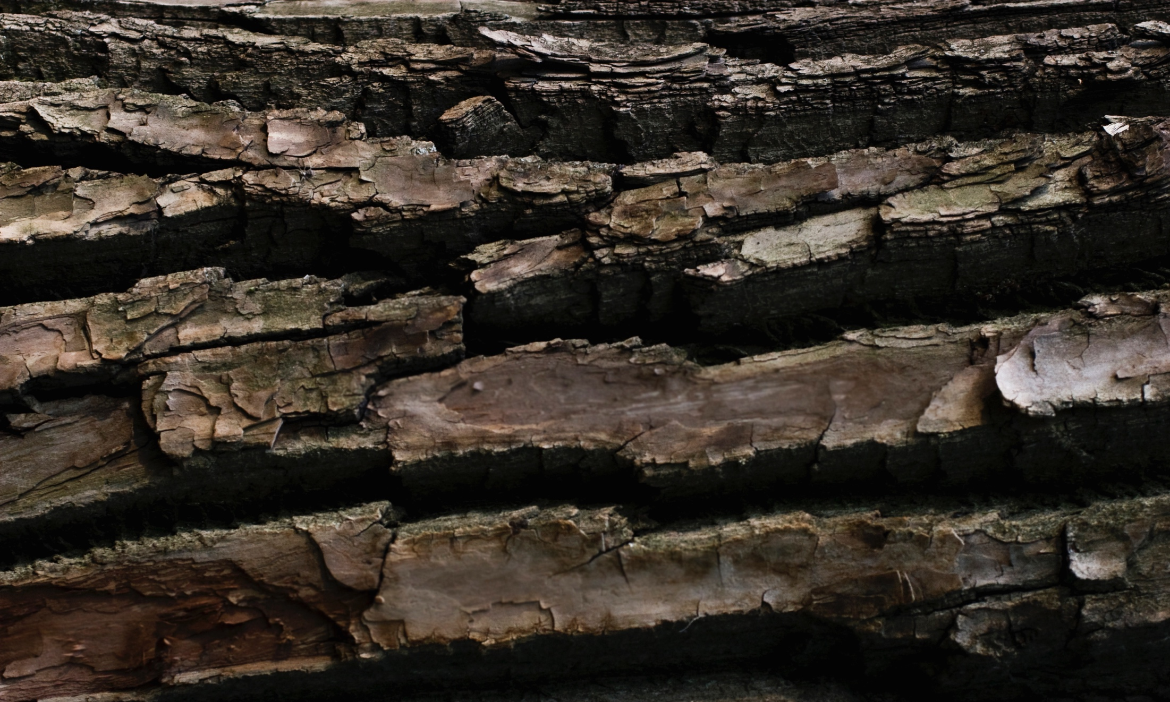
Post-Industrial Revolution

Slide 12
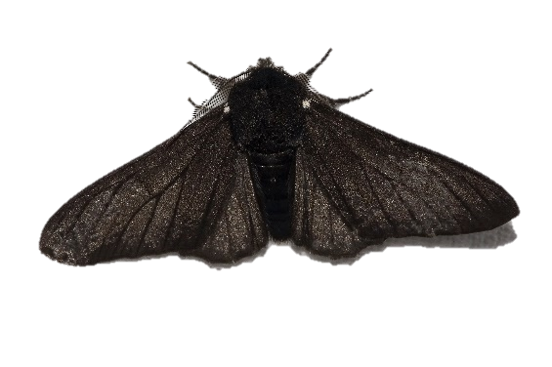
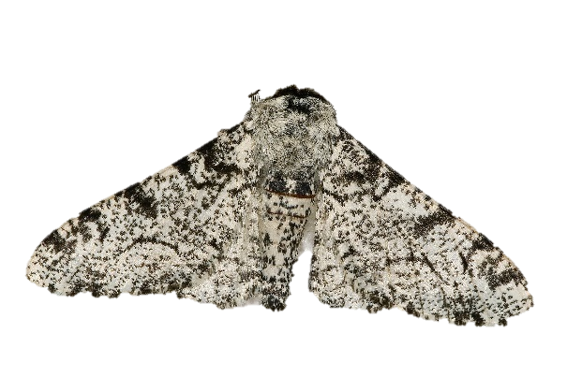

Slide 13
Research It! Station Instructions
Each member of the group will go to the website listed on task card #1.
Complete the task cards in order.
Every student will answer the questions from the task cards on the lab sheet in the Research It! section.
INPUT STATION

Slide 14
Input:
Research
It!
Go to: https://askabiologist.asu.edu/peppered-moths-game/peppered-moth.html
Input:
Research
It!
On the “Peppered Moth” tab, read about the moth’s life cycle and predators.
1 of 5
2 of 5
What color are the “typical” moths?
Describe the trees Peppered Moths use to hide from predators.
Read about the Peppered Moth and answer the questions on the following cards.
Input:
Research
It!
Click on the “How to Play” tab and read the instructions. Then click on the “Play Game” tab.
Input:
Research
It!
Click on the “How to Play” tab and read the instructions. Then click on the “Play Game” tab.
3 of 5
4 o 5
Choose the “Light Forest” option. Record your results.
Which type of moth is easier to catch?
Choose the “Dark Forest” option. Record your results.
Which type of moth is easier to catch?

Slide 15
Input:
Research
It!
Click on the “Natural Selection” tab and read about Genetic Changes and Natural Selection.
5 of 5
What causes the dark coloration of the moths?
What happens to the number of dark moths as the forests become cleaner?

Slide 16
Organize It! Station Instructions
It is recommended that you have completed at least two of the following stations before working at this station.
Read It!
Explore It!
Watch It!
Research It!
Each group will organize the cards. Have your teacher sign off you your Organize it section after it has been checked.
Please mix up the cards again before the next group arrives at this station.
OUTPUT STATION
Do at least two input stations before this.

Slide 17
Natural Selection | Selective Breeding
It takes place over a relatively long period of time. | The process happens due to environmental activity.
It takes place over a relatively short period of time. | Humans have a decision in the outcome of the offspring.
Apples have gotten much larger over the last 30 years due to customer demand. | A Labradoodle is created by scientists to be hypoallergenic but still look similar to a Labrador.
Organisms do not choose to thrive but are selected because they are best adapted to the environment. | Excessive warmer temperatures in a region have caused rabbits with longer fur to slowly disappear.

Slide 18
Illustrate It! Station Instructions
Each member of the group will draw a quick sketch on the lab sheet that shows they understand the concept being taught.
Use the colored pencils and markers that are provided.
The directions for the sketch are provided on the task card at the table.
Use the colored pencils to draw bird beaks that would best be adapted for each situation. You will draw five beaks.
Prey lives inside of small holes on trees
Food is mostly nuts with a very hard shell
Food needs to be scooped off of the ground
Food is berries that live on cactus and are protected by long needles
Food is a tough skinned berry that needs to be sliced open to eat
OUTPUT STATION
Do at least two input stations before this.

Slide 19
Assess It! Station Instructions
It is recommended that you have completed at least two of the following stations before working at this station.
Read It!
Explore It!
Watch It!
Research It!
Each member will answer the questions from the task cards on the lab sheet in the Assess It! section.
OUTPUT STATION
Do at least two input stations before this.

Slide 20
Output:
Assess
It!
A green rat snake that lives in the grass and a brown rat snake that lives in the desert is a form of ______________.
Output:
Assess
It!
Which statement is incorrect
about natural selection?
1 of 4
2 of 4
A single organism can adapt to a cold
environment by growing longer hair.
Over time organisms with longer hair will survive better in cold environments
Humans are not involved in the natural selection process
The offspring of each generation will likely be more adapted to the environment.
Human Genetic Modification
Selective Breeding
Natural Selection
Artificial Breeding
Output:
Assess
It!
Which is a result of selective breeding?
Output:
Assess
It!
Use the vocabulary words from “Read It” to complete the following sentences.
3 of 4
4 of 4
Large seedless watermelons that
consumer demand.
Oranges that are all different sizes and colors.
An insect that can carry ten times its body weight.
A bird that catch prey with its beak.
The breeding of animals is necessary to produce (4)_____. Humans have bred animals and plants for years through the process of (5)_____ in order to hand-select traits needed in the livestock or produce. In nature, it is not quite so simple. Charles Darwin was a naturalist that proposed the idea of (6)_____. When visiting the Galapagos islands, he discovered there was great (7)_____ between the tortoises on different islands. The different tortoises had specific (8)_____ to survive on the islands that they were found on.

Slide 21
Write It! Station Instructions
It is recommended that you have completed at least two of the following stations before working at this station.
Read It!
Explore It!
Watch It!
Research It!
Answer each of the task card questions on the lab sheet in complete sentences.
OUTPUT STATION
Do at least two input stations before this.

Slide 22
Output:
Write
It!
Output:
Write
It!
1 of 4
2 of 3
Explain natural selection in your own words.
Explain selective breeding in your own words.
Output:
Write
It!
Some male peacocks used to have bright and large tails while others had dull, smaller tails. Female peacocks will only mate with the ones that have the brightest and largest tails.
3 of 4
Explain how this would impact the offspring of male peacocks over time.

Slide 23
Challenge It! Station Instructions
All other stations must be completed before you begin this station.
Using the task cards and the data chart provided complete the challenge.
Your completed challenge will be checked by the teacher and/or attached to your answer sheet.
Changes in Moth Populations
YEAR | # of light moths captured | # of dark moths captured
1 | 565 | 65
2 | 535 | 115
3 | 445 | 195
4 | 395 | 205
5 | 250 | 285
6 | 225 | 365
7 | 195 | 410
8 | 150 | 500
9 | 85 | 595
10 | 55 | 640
BONUS STATION
Do all the input and output stations first!

Slide 24
Output:
Challenge
It!
Output:
Challenge
It!
Examine the data provided.
1 of 4
2 of 4
The data table represents data collected over a ten-year study of two varieties of the same species of moth. The numbers show the number of moths captured in traps each year.
What type of graph would be best used to illustrate the data - Bar, line, or pie chart?
What would be the dependent variable? The independent variable?
Output:
Challenge
It!
Use the data to create your chosen graph type.
Output:
Challenge
It!
Examine your completed graph.
3 of 4
4 of 4
Be sure to label your chart with all the appropriate labels.
Be sure to include a key.
Write a claim of what the data means.
Use key vocabulary from the station lab to back up your claim.

Slide 25
______
______
______
4. adaptation | artificial selection | diversity | natural selection | offspring
____________________________
____________________________
____________________________
________________________________________________________
____________________________
____________________________
________________________________________________________
____________________________
____________________________
____________________________
________________________________________________________
____________________________
____________________________
____________________________
____________________________
____________________________
____________________________
____________________________
____________________________
____________________________________________________________________________________
____________________________
____________________________
____________________________
____________________________
____________________________________________________________________________________
____________________________
____________________________
____________________________
____________________________
____________________________________________________________________________________
____________________________
____________________________
____________________________
________________________________________________________
____________________________
____________________________
____________________________
____________________________
________________________________________________________
____________________________
____________________________
____________________________
____________________________
____________________________
________________________________________________________
____________________________
____________________________
____________________________
(Do when ALL other stations are done)
Checked by teacher. Initials: _______
Attached

Slide 26
4. ________________________
5. ________________________
6. ________________________
7. ________________________
8. ________________________
1. ______
2. ______
3. ______
Checked by teacher. Initials: _______
_______________________________________________________
_______________________________________________________
_______________________________________________________
_____________________________________________________________________________________________________________________________________________________________________
_______________________________________________________
_______________________________________________________
_______________________________________________________
_____________________________________________________________________________________________________________________________________________________________________
_______________________________________________________
_______________________________________________________
_______________________________________________________
_____________________________________________________________________________________________________________________________________________________________________

Slide 27
______
______
______
4. adaptation | artificial selection | diversity | natural selection | offspring
____________________________________________
____________________________________________
____________________________________________
________________________________________________________________________________________
____________________________________________
____________________________________________
____________________________________________
________________________________________________________________________________________
____________________________________________
____________________________________________
____________________________________________
________________________________________________________________________________________
______________________________________
______________________________________
______________________________________
______________________________________
______________________________________
______________________________________
______________________________________
______________________________________
______________________________________
______________________________________
______________________________________
______________________________________
______________________________________
______________________________________
______________________________________
______________________________________
______________________________________
______________________________________

Slide 28
1. ______
2. ______
3. ______
Word Bank for 4 - 8:
adaptation
artificial selection
diversity
natural selection
offspring
____________________
____________________
____________________
____________________
____________________
Checked by teacher. Initials: _______

